Slide 1

Student Registration
By: Anay Dwivedi
&
AMAN DWIVEDI

Slide 2
About Student Registration System
In Student Registration System any institution can register any new student details.
It also comprises of displaying all registered students details.
i.e. Students Name
Parents detail
D.O.B
Address

Slide 3
Features
This System helps Universities or school authorities to store or display students data in online mode(before this all the data were handled manually).
It is cost efficient and consume less time as compared to manual handling.
Manage Students' Records & Data in Digital Format.
Enquiry about any student is pretty simple and quick.

Slide 4
Data Structure concept used
Singly linked list : A singly linked list is a type of linked list that is unidirectional, that is, it can be traversed in only one direction from head to the last node (tail). Each element in a linked list is called a node. A single node contains data and a pointer to the next node which helps in maintaining the structure of the list.
Array : Array in C can be defined as a method of clubbing multiple entities of similar type into a larger group. These entities or elements can be of int, float, char, or double data type or can be of user-defined data types too like structures.

Slide 5
Function Used to build this System
add_student()
//this function is used to add students detail i.e. Studentname,parents name,D.O.B.,address etc
displayallstudents()
// it is used to display all the detail regarding students which we have given in add_student() function.
DeleteAllStudents()
//it contain information regatding deletion of stuents record.

Slide 6
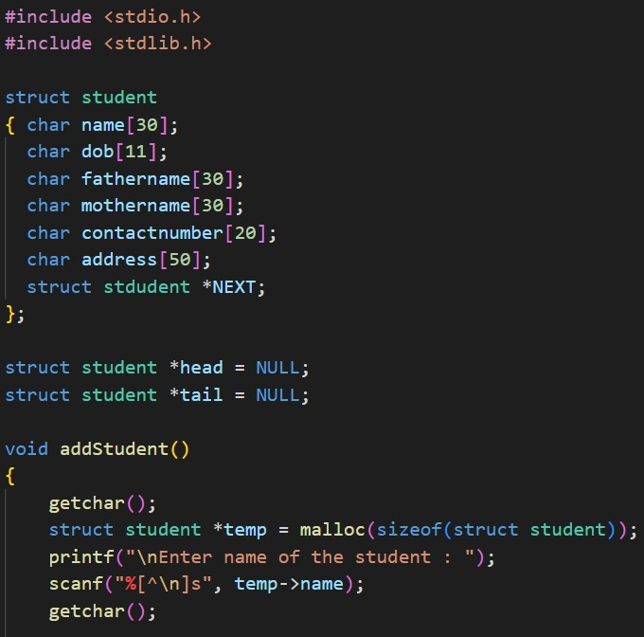
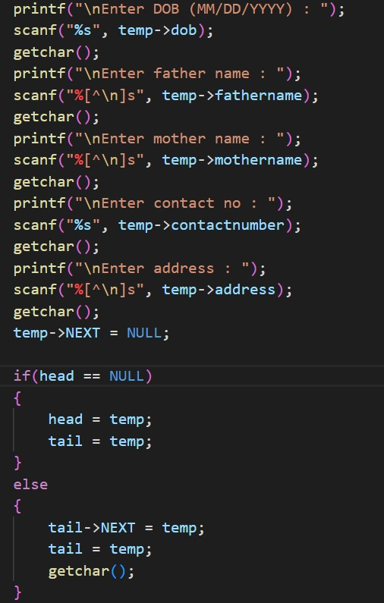
CODE

Slide 7
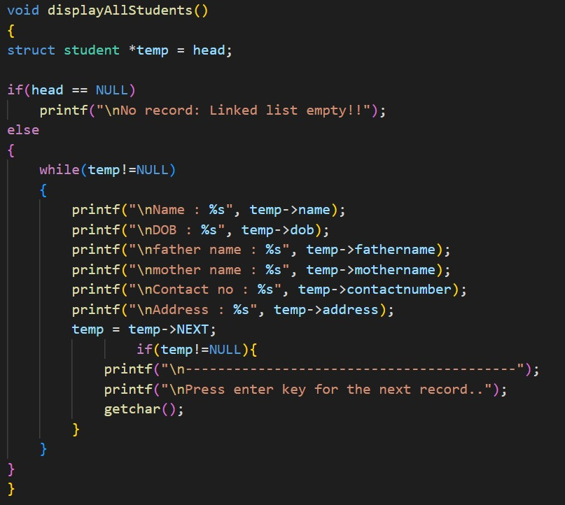
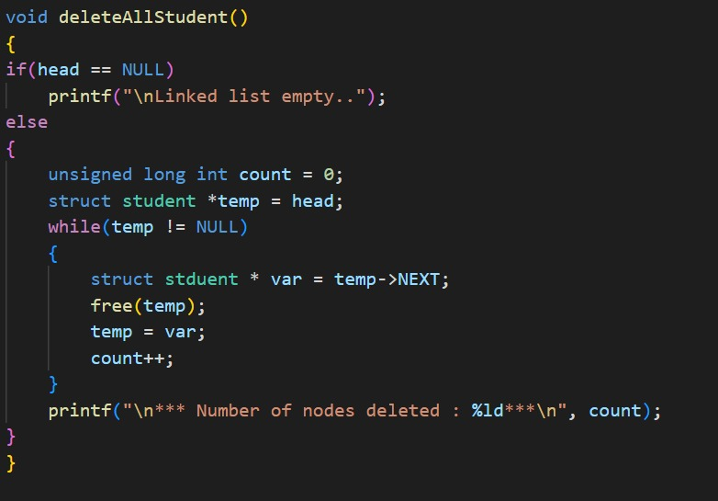

Slide 8
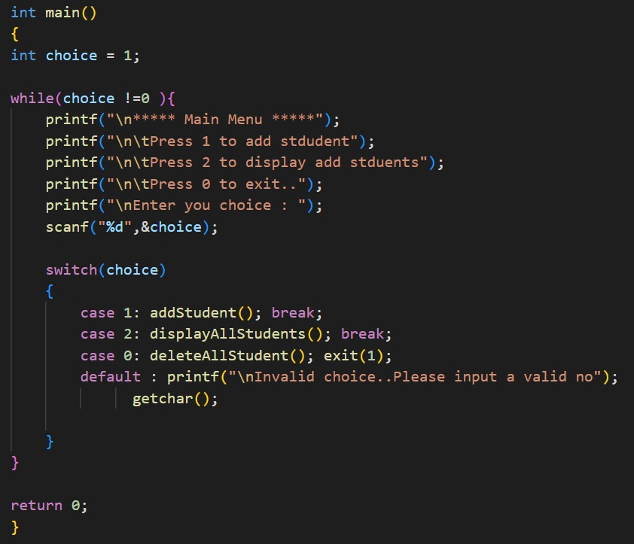

Slide 9
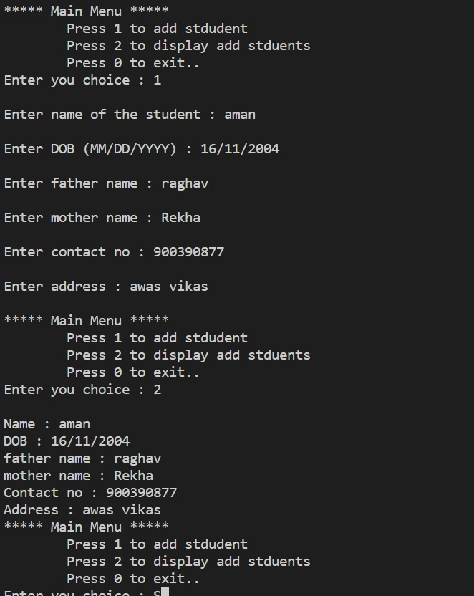
OUTPUT

